Slide 1
Graph theory
Lyernisha S R
Lecturer,SCS

Slide 2

Consider a relation 𝑊on the set D={1,2,3,4,5,6}. Describe explicitly which edges are introduced/removed in the following descriptions:
1.Removing two of the edges from𝐺results in a graphical representation of an irreflexive relation on 𝐷
2.Adding five edges to 𝐺results in a graphical representation of a symmetric relation on 𝐷.
3.Adding three edges to 𝐺results in a graphical representation of a transitive relation on 𝐷.

Slide 3
What is a Graph?
A graph G is a pair of sets G=(V, E),where Vis the set of vertices and E is the set of edges, connecting the pairs of vertices.

Slide 4
Applications of Graph Theory
Electrical Engineering: hardware design (topology)
Computer Science: algorithms
Computer Network: interconnected computers or routers
Science: molecular, chemical and DNA structures

Slide 5
Simple Graphs
A simple graph is a graph that has the following properties:
–No loops (no edge from a vertex to itself)
–Maximum of one edge between any two distinct vertices
–No sense of direction in the edges

Slide 6
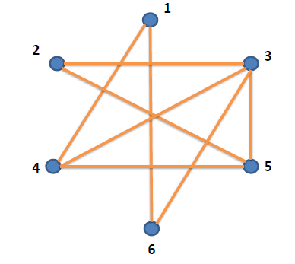
Example of a Simple Graph
V={1,2,3,4,5,6}
E={{1,4}, {1,6}, {2,3}, {2,5}, {3,4}, {3,5}, {3,6}, {4,5}}

Slide 7
Directed Graphs
A directed graph is a graph that has the following properties:
–Loops are allowed.
–Maximum of one edge from one vertex to another.
–Each edge has a sense of direction.
–E.g., V={1,2,3,4,5,6}
E={(1,1), (1,4), (2,3), (2,5), (3,5),
(4,3), (4,4), (5,3), (5,4), (6,1),(6,3)}

Slide 8
Walks
A walk in a simple graph is an ordered sequence of vertices in which, for every two adjacent vertices, there is an edge that is incident to the two vertices.
A walk in a directed graph is an ordered sequence of vertices in which, for every two adjacent vertices, there is an edge that first and second vertices are, respectively, the start and end vertex of the edge.

Slide 9
Can you find seven different walks from Vertex 5 to Vertex 3?
1.5 2 5 2 3
2.5 2 3 5 3
3.5 2 5 4 3
4.5 4 4 4 3
5.5 4 3 5 3
6.5 3 5 4 3
7.5 3 5 2 3

Slide 10
Length of Walk
The length of walk is the number of edges that are traversed in the walk.

Slide 11
Path
Let 𝐺=(𝑉,𝐸) be a graph. A path in G is a walk in which no vertex appears more than once in the sequence of vertices.

Slide 12
Cycle
A cycle in a graph is a walk in which the start and end vertices are the same vertex. Except the two vertices, no vertex appears more than once.

Slide 13
Order and Size
Let 𝐺=(𝑉,𝐸) be a graph, and the order of the graph is given by |V|, the number of vertices in the graph. The size of the graph is given by |E|, the number of edges in the graph.

Slide 14
Adjacent and Incident
Simple Graph:
Let 𝐺=(𝑉,𝐸) be a simple graph and let 𝑥,𝑦 ∈ 𝑉such that {x,y} ∈𝐸
The vertices x,y are said to be adjacent
The edge {x,y} is incident to both x and y.
Directed Graph:
–Let 𝐺=(𝑉,𝐸) be a simple graph and let 𝑥,𝑦 ∈𝑉such that (𝑥,𝑦)∈𝐸
x is said to be adjacent to y,
y is adjacent from x,
X is the start vertex of the edge (x,y),
Y is the end vertex of the edge (x,y).

Slide 15
Degree of Vertices
Simple Graph:
Let 𝐺=(𝑉,𝐸) be a simple graph and let 𝑥∈𝑉. The degree of vertex 𝑥 is the number of edges that are incident to 𝑥, denoted by 𝛿(𝑥).
Directed Graph:
Let 𝐺=(𝑉,𝐸) be a directed graph and let 𝑥∈𝑉.
The in-degree (𝜹⁻(𝒙)) of vertex 𝑥 is the number of edges for which 𝑥 is the end vertex.
The out -degree (𝛿⁺(𝑥)) of vertex 𝑥 is the number of edges for which 𝑥 is the start vertex.

Slide 16
Degree Sequence of a Graph
Simple graph
–The degree sequence of a simple graph is a non-increasing sequence of the vertex degrees of the graph’s vertices.
–E.g., (4,3,3,2,2,2)
Directed graph
–In-degree sequence
–Out-degree sequence

Slide 17
Connected
A graph is said to be connected if, for every vertex, there exists a walk to every other vertex in the graph.

Slide 18
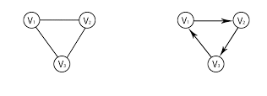
The Handshaking Theorem
Simple Graph
The sum of the degree sequence equals twice the size of the graph.
Directed graph
The following three values are equal
The sum of the in-degree sequence
The sum of the out-degree sequence
The size of the graph

Slide 19
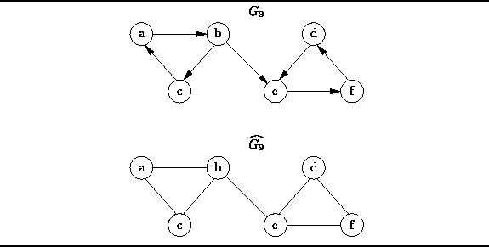

Slide 20
Representing Graphs
Adjacency Matrix: 𝑛×𝑛 zero - one matrix
–Let 𝐺=(𝑉,𝐸) be a graph of order 𝑛, and 𝑉={𝑣1,𝑣2,…,𝑉𝑛}
–Simple graph:
𝑀_{𝑖,𝑗}=𝑀_{𝑗},_{𝑖}=1if v_{i},v_{j}∈𝑬, otherwise is zero
–Directed graph:
𝑀_{𝑖,𝑗}=1if (v_{i},v_{j})∈𝑬, otherwise is zero

Slide 21
Adjacency matrix

Slide 22
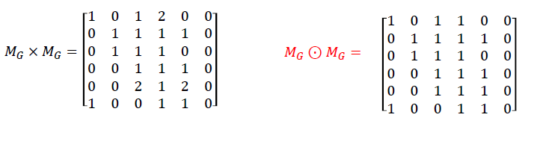
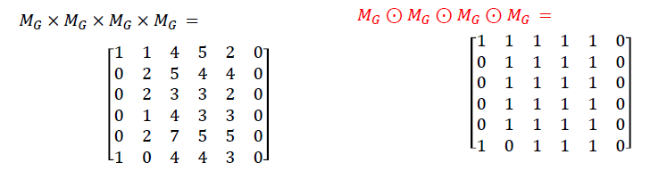
Boolean Product

Slide 23
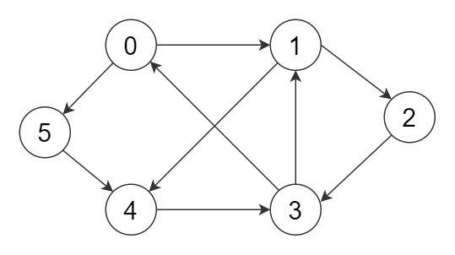

Slide 24
Equal Graphs
Two graphs, 𝐺₁=(𝑉₁,𝐸₁)and 𝐺₂=(𝑉₂,𝐸₂)are deemed to be equal if and only if both the following hold:
–𝑉₁=𝑉₂
–𝐸₁=𝐸₂
The equality among graphs usually refers to isomorphism within graphs.

Slide 25
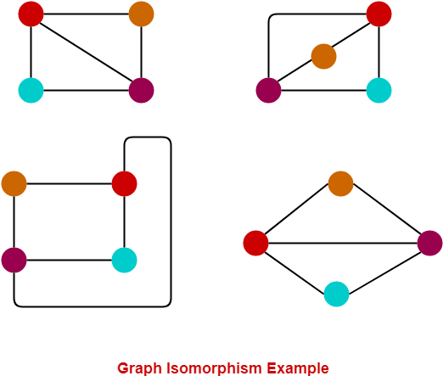
Example

Slide 26



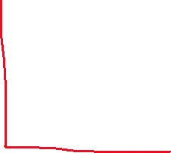






Slide 27
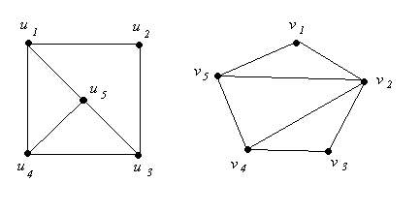
Check for isomorphism

Slide 28
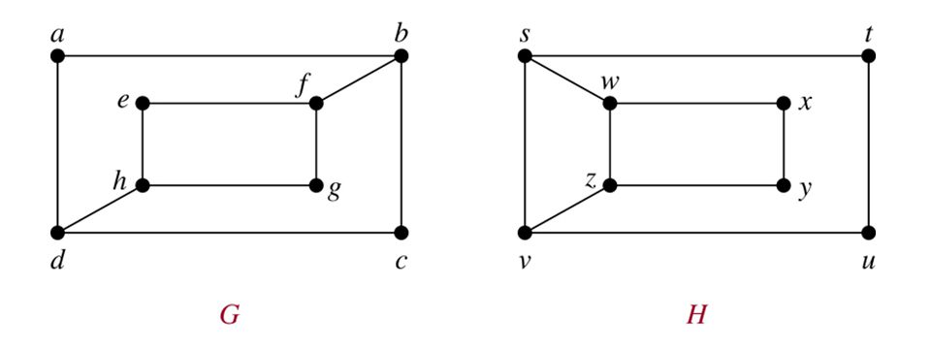

Slide 29
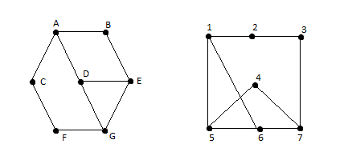
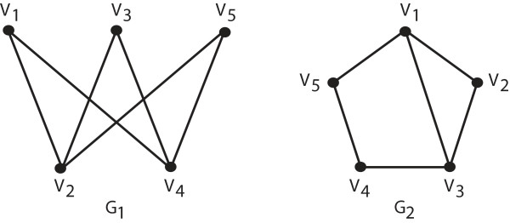
Isomorphic graphs ?

Slide 30
Special Simple Graphs
Regular graph
All vertices have the same degree
Complete graph
Every vertex is adjacent to every other vertex
Empty graph
𝐸=∅
Bipartite graph
V can be partitioned into two parts such that no pairs if vertices in the same part are adjacent.

Slide 31
Bipartite graph
The vertex set of can be partitioned into two disjoint and independent sets and.
All the edges from the edge set have one endpoint vertex from the set and another endpoint vertex from the set.

Slide 33





Check for bipartite property

Slide 34
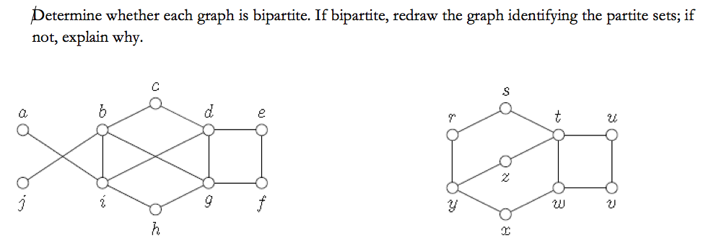

Slide 35
Thank you!

